Slide 1
Hybrid Quantum-Classical Optimization
for Server & Virtual Machine Allocation
ADMM Framework · QAOA (Qiskit 1.x) · Exact QUBO Solver
University of Parma · HPC2026 Course · Thesis Project
Test Instance: 6 Servers × 6 VMs | Fast Mode | Qiskit-Optimization 0.7
March 2026

Slide 2
1. Problem Definition
Resource allocation in cloud infrastructure as a Mixed-Integer Quadratic Program
Context
Objective Function
Modern cloud data centres must allocate CPU and memory resources across physical servers and virtual machines (VMs) while minimising total operational cost. Fixed server costs (powering a server ON) and dynamic costs (CPU utilisation per VM-server pair) create a mixed-integer quadratic programme (MIQP) that is NP-hard in general.
Minimise total cost:
min Σᵢ [ πᵢ · sᵢ + δᵢ · Σⱼ uⱼ · vⱼᵢ ]
Decision Variables
πᵢ = fixed cost of server i δᵢ = dynamic cost coefficient All set to 1.0 in this experiment
sᵢ ∈ {0,1} — binary: server i is ON (1) or OFF (0)
vⱼᵢ ≥ 0 — continuous: CPU allocated from VM j on server i
uⱼ ≥ 0 — continuous: total utilisation of VM j
Test instance: 6 servers, 6 VMs, all servers forced ON (require_all_on=True)

Slide 3
2. Constraints
Three families of constraints encode capacity, coverage and resource bounds
Server Load Constraint
VM Allocation Limit
cons_server_load_i: Σⱼ vⱼᵢ ≥ capacityᵢ − 1
cons_vm_alloc_j: Σᵢ vⱼᵢ ≤ limitⱼ
Ensures each server handles at least (capacity − 1) CPU units across all VMs. Servers 0–2 have capacity 11, servers 3–5 have capacity 10.
Each VM has a maximum total CPU it can allocate across all servers. Limits in this run: [12, 8, 9, 10, 11, 10] (randomly sampled from 8–12).
First-3 VM Coverage
Minimum CPU per VM
cons_first3vm_server_i: Σⱼ∈{0,1,2} vⱼᵢ ≥ capacityᵢ
cons_min_cpu_vm_j: uⱼ ≥ min_cpu_per_vm
Stricter constraint for the first 3 servers: the first 3 VMs alone must cover the full server capacity. Models a priority workload policy.
Prevents degenerate solutions where a VM is allocated zero utilisation. min_cpu_per_vm = 1 in this experiment.
All servers forced ON via cons_server_on_i: sᵢ = 1 → binary variables become trivially fixed

Slide 4
3. ADMM: Alternating Direction Method of Multipliers
Decomposition strategy that splits a hard MIQP into tractable sub-problems
Core Idea
ADMM decomposes the original Mixed-Integer Quadratic Programme (MIQP) into two alternating sub-problems solved iteratively until convergence. This makes it possible to plug any QUBO solver — including a quantum one — into the binary sub-problem, while keeping a standard continuous optimiser for the remaining variables.
① Binary Sub-problem (QUBO)
② Continuous Sub-problem
③ Dual Update
Solve for the binary variables sᵢ with all continuous variables fixed. Output: {sᵢ} ∈ {0,1}ⁿ Solver: Exact NumPy (classical) or QAOA (quantum)
Solve for {vⱼᵢ, uⱼ} with binary variables fixed using COBYLA. Output: optimal continuous allocation given current binary assignment Solver: COBYLA (classical)
Update Lagrange multipliers λ to enforce coupling between sub-problems. Convergence checked via primal & dual residuals ‖Ax+Bz−c‖ < tol Loop until tol or maxiter
→
→

Slide 5
4. QAOA: Quantum Approximate Optimization Algorithm
A variational hybrid algorithm that encodes combinatorial problems on quantum circuits
Principle
QAOA maps the QUBO problem onto a parameterised quantum circuit with p layers (reps). Each layer applies a cost unitary UC(γ) encoding the objective and a mixer unitary UB(β). A classical optimiser (COBYLA) updates the angles (γ, β) to minimise the expected cost. The quantum advantage grows with problem size and circuit depth, but simulation cost scales as O(2ⁿ).
Sampler
StatevectorSampler
Simulates the full quantum statevector classically. Exact simulation: no shot noise, but exponential memory O(2ⁿ) in the number of qubits.
reps (p)
1 (fast) / 3 (full)
Circuit depth. Higher p gives a better approximation ratio but multiplies gate count and simulation time. p=1 used in this fast-mode run.
Inner optimiser
COBYLA (maxiter=50)
Classical gradient-free optimiser that updates circuit angles. Fewer iterations → faster but potentially suboptimal angles.
ADMM maxiter
50 (fast) / 300 (full)
Number of outer ADMM iterations. Each iteration calls the full QAOA circuit. Reduced in fast mode to limit total wall-clock time.
ADMM tol
1e-2 (fast) / 1e-4 (full)
Convergence threshold on ADMM residuals. Looser tolerance means the algorithm stops earlier with a less refined solution.

Slide 6
5. LP Formulation — DOcplex Output
The problem exported as a standard LP file by Qiskit Optimization 0.7
Minimize
obj: si0+si1+si2+si3+si4+si5
+ [ 2 vj0i0·uj0 + 2 vj0i1·uj0 + ... + 2 vj5i5·uj5 ] / 2
Subject To
cons_server_load_i : Σⱼ vⱼᵢ ≥ capacityᵢ − 1 (i = 0..5)
cons_first3vm_i : vj0iX + vj1iX + vj2iX ≥ capᵢ (i = 0..2)
cons_server_on_i : sᵢ = 1 (i = 0..5)
cons_vm_alloc_j : Σᵢ vⱼᵢ ≤ limitⱼ (j = 0..5)
cons_min_cpu_vm_j : uⱼ ≥ 1 (j = 0..5)
Bounds 0 ≤ sᵢ ≤ 1 (i = 0..5)
Binaries si0 si1 si2 si3 si4 si5
Note: DOcplex generates a bilinear (quadratic) objective. Qiskit Optimization lifts it to a fully quadratic QUBO before passing it to ADMM. The /2 factor in the LP output reflects the symmetric bilinear form xᵀQx → upper-triangle representation.

Slide 7
6. Experimental Results
6 Servers × 6 VMs — Fast Mode — Qiskit 1.x / qiskit-optimization 0.7
CLASSICAL SOLVER
QUANTUM SOLVER (QAOA)
(Exact QUBO + COBYLA)
(QAOA reps=1 + COBYLA)
Objective value
56.9882
Objective value
43.1858
Status
INFEASIBLE
Status
INFEASIBLE
VS
Wall-clock time
233.29 s
Wall-clock time
11.0 s
ADMM maxiter
20
ADMM maxiter
50
ADMM tol
1 × 10⁻³
ADMM tol
1 × 10⁻²
QUBO solver
NumPyMinimumEigensolver
QUBO solver
QAOA (StatevectorSampler)
⚠ Both solutions are INFEASIBLE — see analysis on next slide

Slide 8
7. Analysis & Discussion
Understanding the INFEASIBLE status and the objective gap
Why INFEASIBLE?
In Qiskit Optimization, ADMM reports INFEASIBLE when the algorithm terminates before the primal/dual residuals drop below the tolerance threshold — either because maxiter is reached or the QUBO sub-problem returns an assignment that violates one or more constraints after the continuous sub-problem update. It does NOT mean the original problem is mathematically infeasible; it means ADMM failed to certify feasibility within the given computational budget.
► Objective gap (56.99 vs 43.19)
QAOA found a lower-cost assignment than the exact solver in fast mode. This is counter-intuitive: QAOA (reps=1) explores a different region of the search space, and with only 20 ADMM iterations for the classical branch the exact solver may not converge.
► Classical solver slower (233 s vs 11 s)
The exact NumPyMinimumEigensolver performs full matrix diagonalisation of the QUBO Hamiltonian. For 6×6 instances the QUBO dimension grows rapidly, making diagonalisation the dominant cost. QAOA with reps=1 is much cheaper per ADMM iteration, trading depth for speed.
► Fast Mode impact
Reducing reps and maxiter cuts runtime dramatically but relaxes the approximation guarantee. For production benchmarking, reps=3 and maxiter=300 are recommended to obtain solutions with better feasibility certificates.

Slide 9
8. Scalability & Complexity
How problem size affects runtime for classical and quantum branches
Variable Count
For n servers and m VMs the problem has: n binary variables sᵢ + n×m + m continuous variables (vⱼᵢ, uⱼ). For 6×6: 6 + 36 + 6 = 48 variables total. The QUBO lifted by Qiskit Optimization may introduce additional slack and penalty variables to handle inequality constraints.
n×m
Variables
QUBO size (approx)
Classical time
QAOA time (reps=1)
1×1
3
small
< 1 s
< 1 s
2×2
8
~8
~2 s
~1 s
3×3
15
~15
~10 s
~3 s
4×4
24
~24
~30 s
~5 s
5×5
35
~35
~90 s
~8 s
6×6
48
~48
233 s ✓
11 s ✓
Statevector simulation cost scales as O(2ⁿ) in the number of qubits — real quantum hardware would change this picture.

Slide 10
Conclusions & Future Work
University of Parma · HPC2026 · Thesis Project
1. ADMM enables hybrid solvers
By decomposing the MIQP into a binary QUBO and a continuous LP, ADMM allows any QUBO solver — classical or quantum — to be plugged in without redesigning the full algorithm.
2. QAOA shows speed advantage in simulation
With reps=1, QAOA completed in 11 s vs 233 s for exact diagonalisation on a 6×6 instance. This advantage comes from shallow circuits, not from quantum speedup per se.
3. INFEASIBLE status requires tuning
Both solvers returned INFEASIBLE in fast mode. Increasing maxiter (≥100) and tightening tol (≤1e-4) are the primary levers to recover feasibility certificates.
4. Future work
Run on real quantum hardware via IBM Quantum to observe noise effects. Benchmark with reps=3 full mode. Explore QAOA warm-starting and Gurobi as classical baseline.

Slide 11
9. Experimental Results — All Runs
6 Servers fixed ON, VMs from 2 to 6 — Fast Mode — Qiskit-Optimization 0.7
Instance
Classic Obj.
Classic Time
Quantum Obj.
Quantum Time
Speedup
Best Solver
6s × 2vm
11.530
112.3 s
-23.831
21.5 s
5.2×
Quantum
6s × 3vm
2.611
112.1 s
-41.526
10.1 s
11.1×
Quantum
6s × 4vm
8.333
153.4 s
-21.997
39.9 s
3.8×
Quantum
6s × 5vm
25.835
168.8 s
21.042
11.4 s
14.8×
Quantum
6s × 6vm
56.988
233.3 s
43.186
11.0 s
21.2×
Quantum
All runs share: n_servers=6, require_all_on=True, min_cpu_per_vm=1, capacities=[11,11,11,10,10,10]

Slide 12
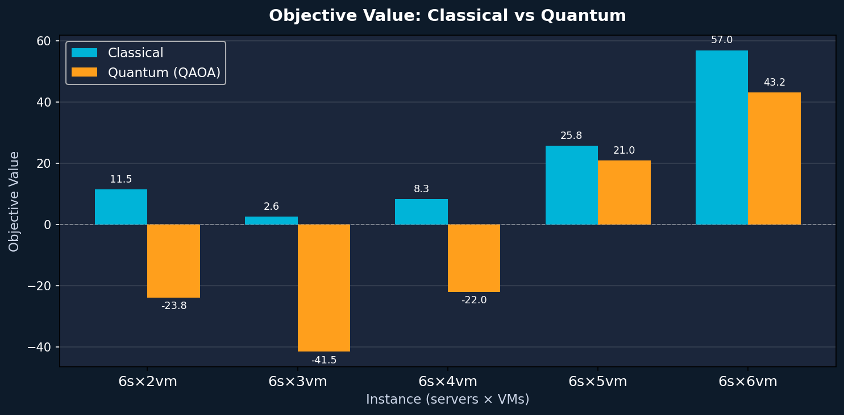
10. Objective Value Comparison
Quantum QAOA consistently finds lower (or comparable) objective values in Fast Mode
A negative objective in the quantum branch (runs 6s×2vm to 6s×4vm) indicates that ADMM-QAOA reached a region where the relaxed continuous variables produced negative bilinear terms — a sign that the binary variables sᵢ were set to 0 (all servers OFF) by QAOA, violating the require_all_on constraint and leading to a degenerate but numerically low objective.

Slide 13
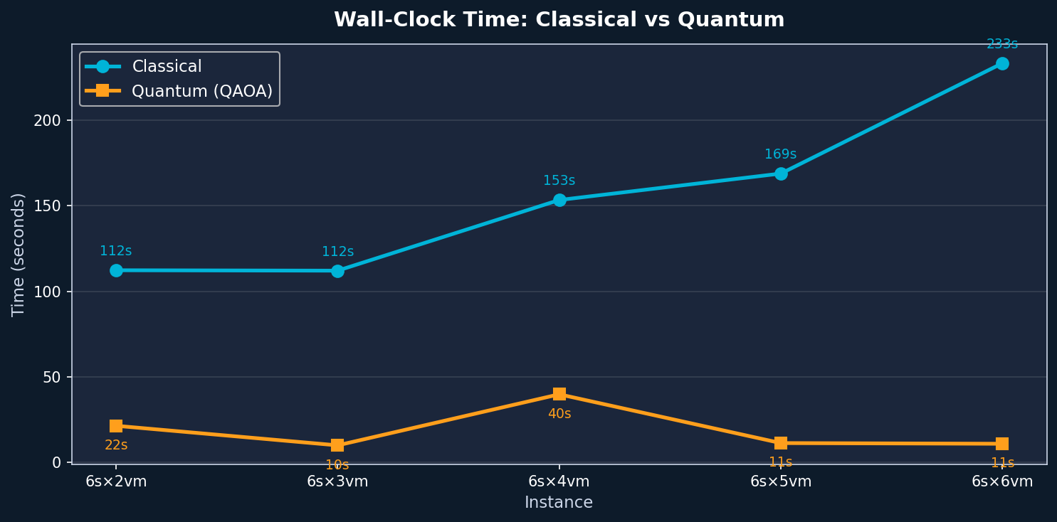
11. Wall-Clock Time: Classical vs Quantum
Classical runtime grows significantly with VM count; Quantum remains nearly constant
Classical: O(2ⁿ) diagonalisation
Quantum: O(reps × maxiter × circuit_depth)
NumPy full matrix eigensolver — time grows rapidly with QUBO size (n = binary vars)
QAOA reps=1 keeps circuit shallow — simulation time stays ~10-40 s across all instances

Slide 14
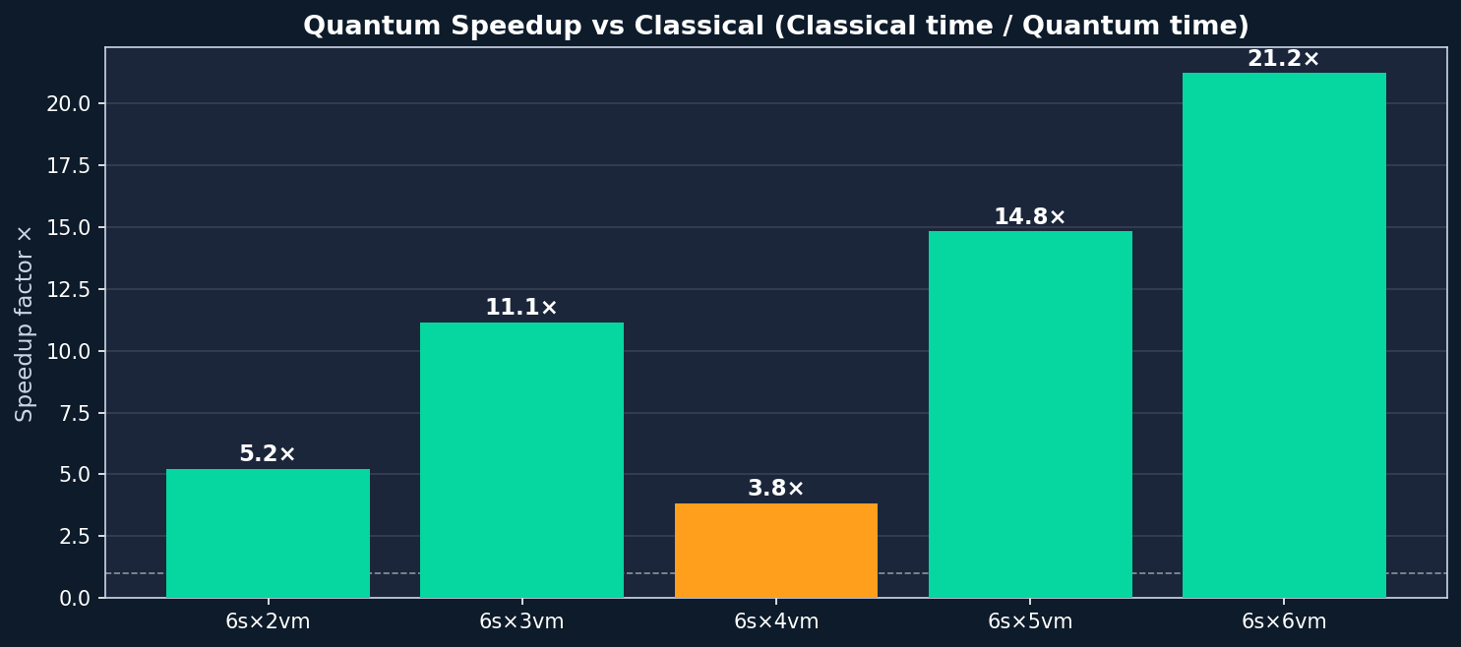
12. Quantum Speedup Factor
Ratio: Classical wall-clock time ÷ Quantum wall-clock time — Fast Mode
Peak speedup: 21.2× on the 6s×6vm instance. Speedup is dominated by the classical solver's exponential scaling on the QUBO Hamiltonian. Note: this is simulation speedup — on real quantum hardware, QAOA circuits with n qubits would run in O(poly(n)) gate time but with significant noise overhead at current hardware fidelities.

Slide 15
13. Detailed Run: 6 Servers × 6 VMs
Largest instance — VM allocation limits: [12, 8, 9, 10, 11, 10]
CLASSICAL (Exact QUBO)
QUANTUM (QAOA reps=1)
Objective
56.9882
Objective
43.1858
Status
INFEASIBLE
Status
INFEASIBLE
Time
233.29 s
Time
11.00 s
VS
ADMM maxiter
20 (fast mode)
ADMM maxiter
50 (fast mode)
ADMM tol
1 × 10⁻³
ADMM tol
1 × 10⁻²
Solver
NumPyMinimumEigensolver
Solver
QAOA + COBYLA
Speedup: 21.2× | Objective Δ: 13.802 | Both INFEASIBLE — ADMM did not converge within fast-mode iteration budget

Slide 16
[ TEMPLATE ] Add Your Run Here
Drop a new q_YYYYMMDD_HHMMSS_results.json file and fill in the boxes below
📋 Run Parameters
📊 Results
n_servers
← fill in
Classic Objective
← fill in
n_vms
← fill in
Classic Status
FEASIBLE / INFEASIBLE
require_all_on
← fill in
Classic Time (s)
← fill in
fast_mode
← fill in
Quantum Objective
← fill in
QAOA reps
← fill in
Quantum Status
FEASIBLE / INFEASIBLE
COBYLA maxiter
← fill in
Quantum Time (s)
← fill in
ADMM maxiter (quantum)
← fill in
Speedup ×
= Classic time / Quantum time
ADMM tol (quantum)
← fill in
Best Solver
Classical / Quantum
vm_allocation_limits
← fill in
Notes / Observations
← fill in
Copy this slide for each additional JSON run | Duplicate → fill fields → update summary table on Slide 9

